Slide 1
Airbnb Data Analysis
Chunyu Chen
Zongjie Yin

Slide 2
Background
Airbnb is a double-edged market (Renter and Landlord)
For renter:
Provide the relative price range for similar houses in order to save rent
For landlord:
Provide the relative price range for similar houses in order to increase competitiveness

Slide 3
Purpose
Using provided information to predict price of given house that is in the Airbnb list in NY state.
X variables: columns in the data-set(does not includes price)
Y variable: price of given house

Slide 4
Background
Data from Kaggle: https://www.kaggle.com/c/airbnblala/data
Each row in the data set means one house in the Airbnb list in NY state
There are total 29142 rows × 96 columns in the data set
Columns information includes:
Housing basic information: Url link, location, house rules, pictures...
Household information: responding time, listing houses count...
Review scores: overall rating, accuracy, cleanliness, communications...

Slide 5
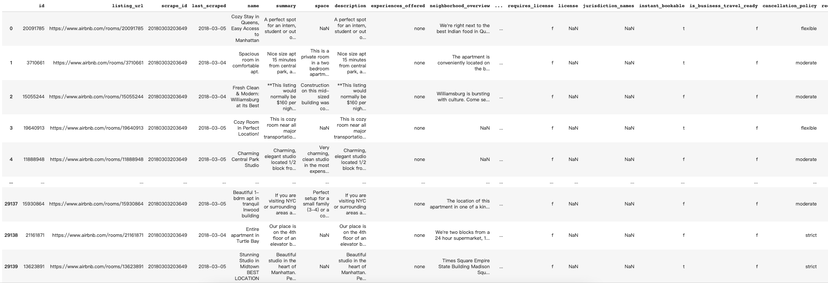
Example of data

Slide 6
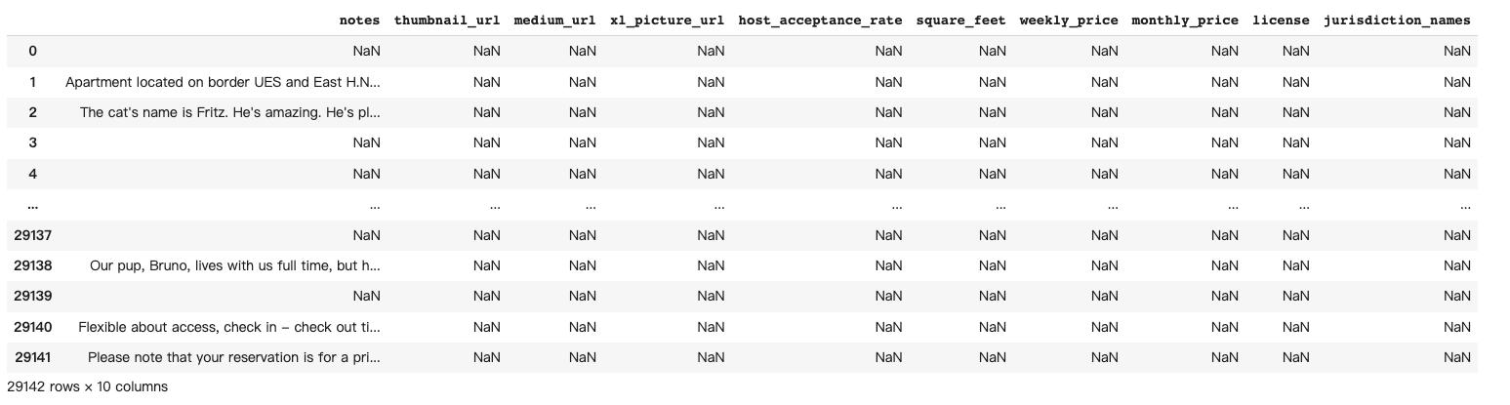
Data Cleaning
Price of house should >= 0 (25 rows house price = 0)
10 columns that have missing values over 50%
We delete 10 columns that having missing value over 50% and 25 rows with house price = 0.

Slide 7
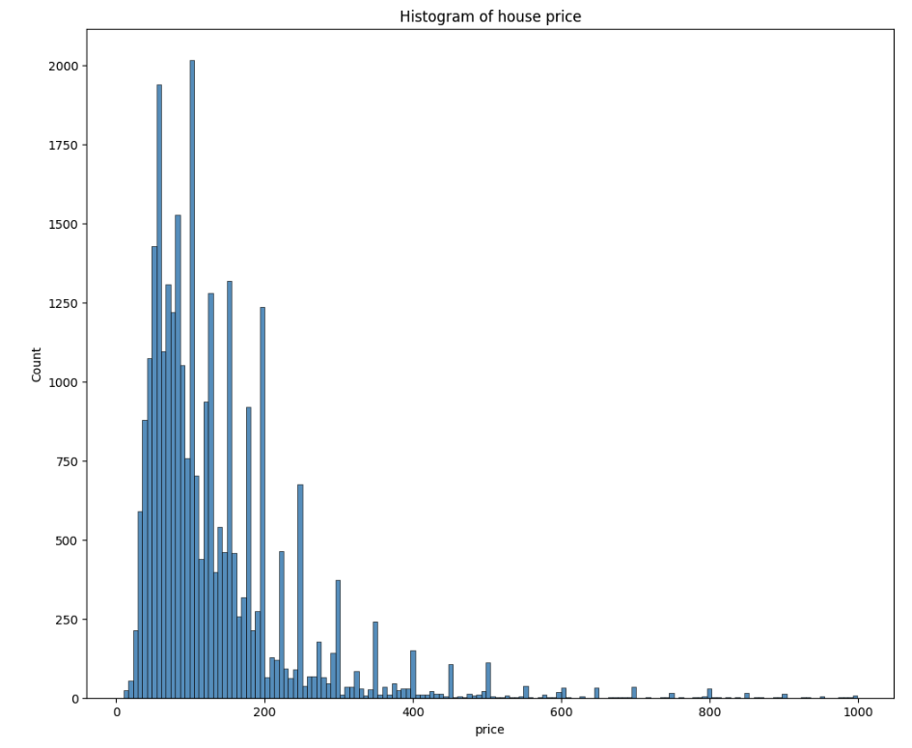
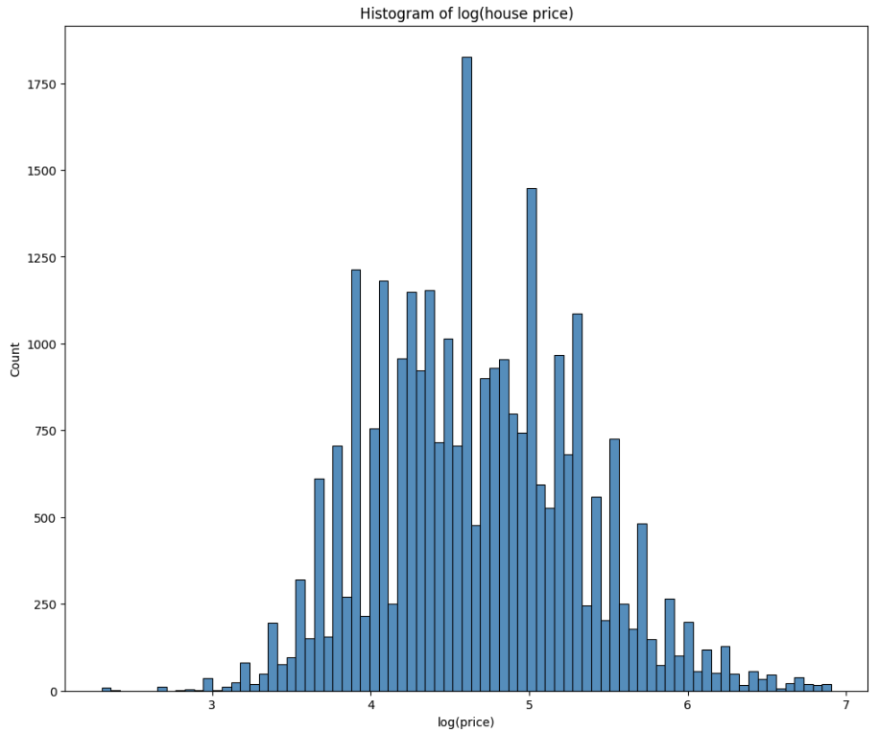
Data Remain After Cleaning
There are 29117 rows × 86 columns left
32 columns are numerical variables
54 columns are ordinal variables

Slide 8
Data Visualization

Slide 9
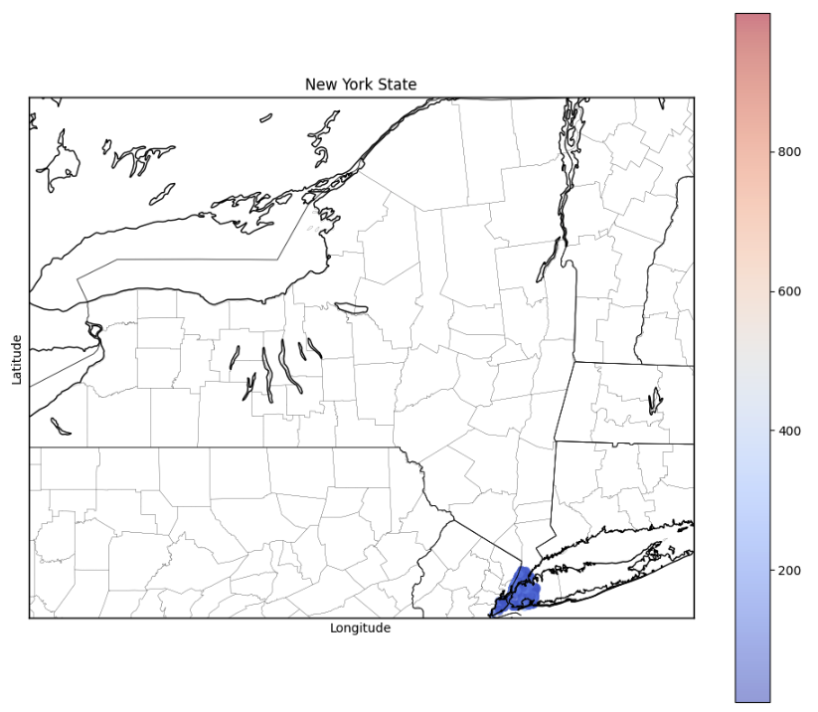
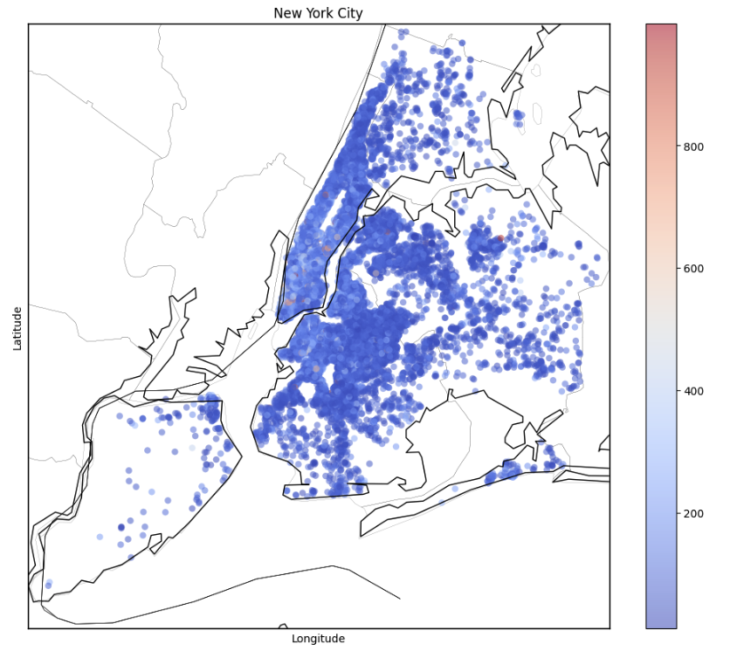
Price V.S. Location of House

Slide 10
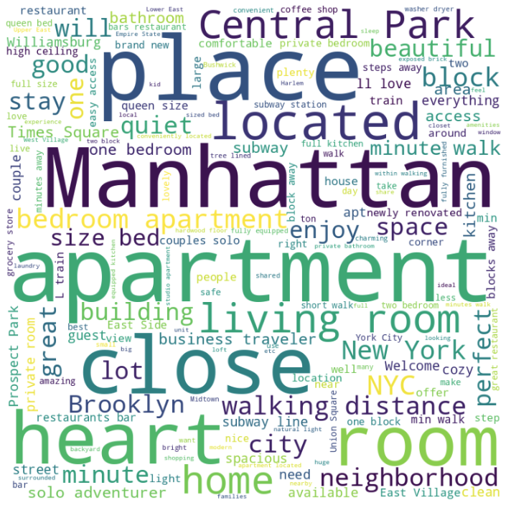
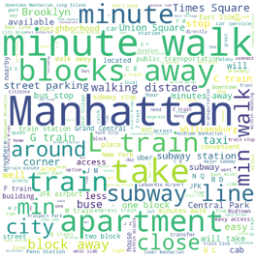
Word Could
Summary Column
Transit Column

Slide 11
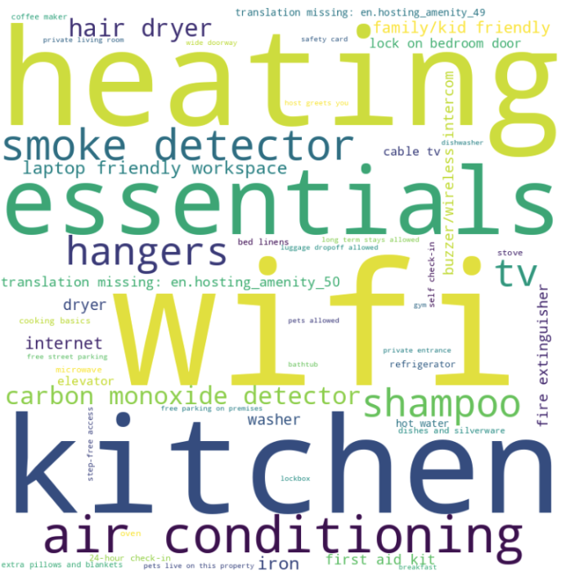
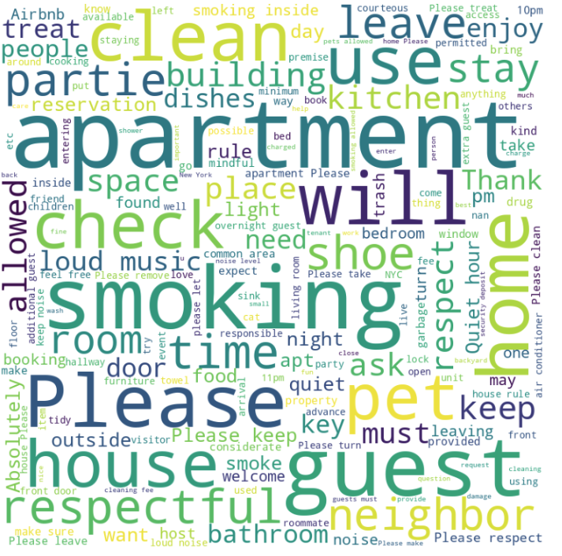
Word Could
Amenities Column
House rules Column

Slide 12
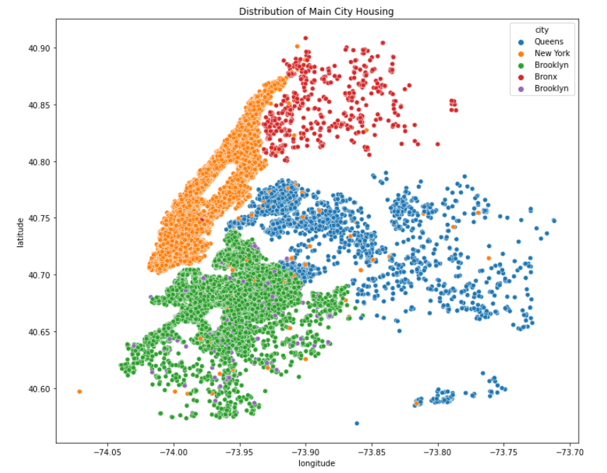
Location of House

Slide 13
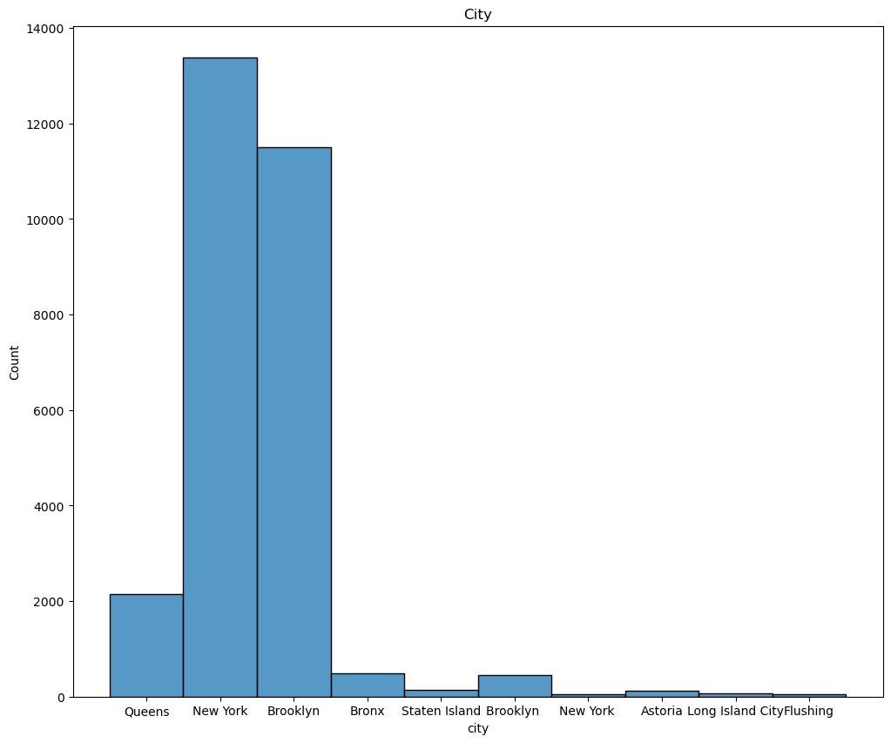
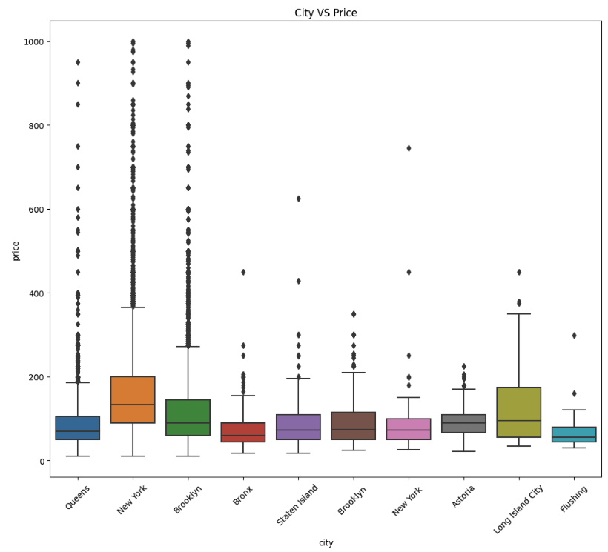
House Location as City

Slide 14
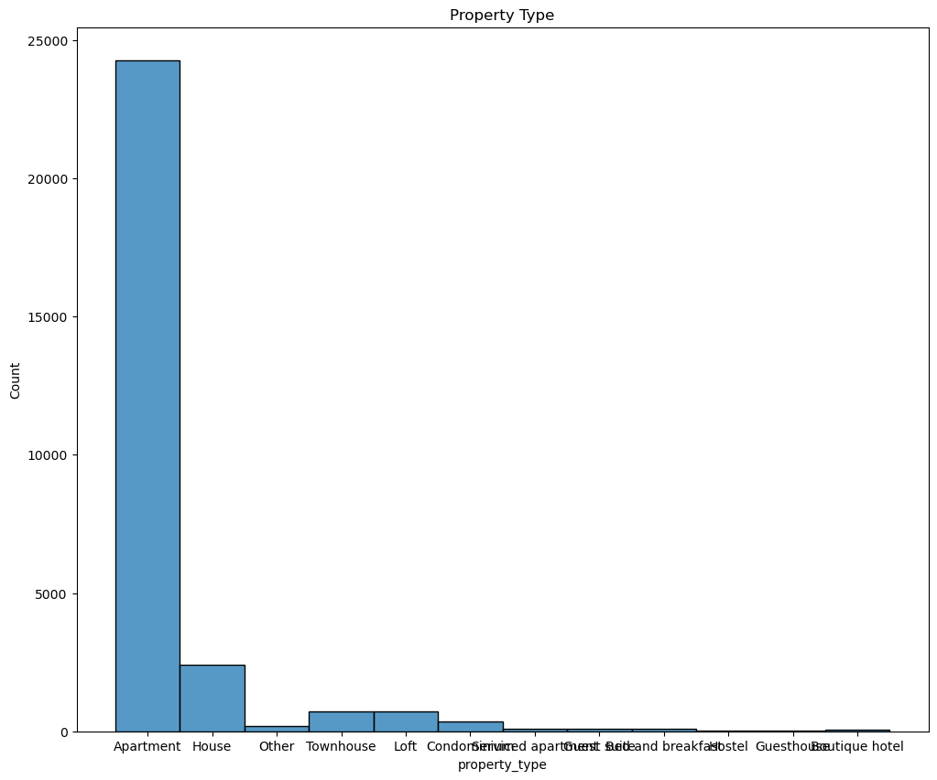
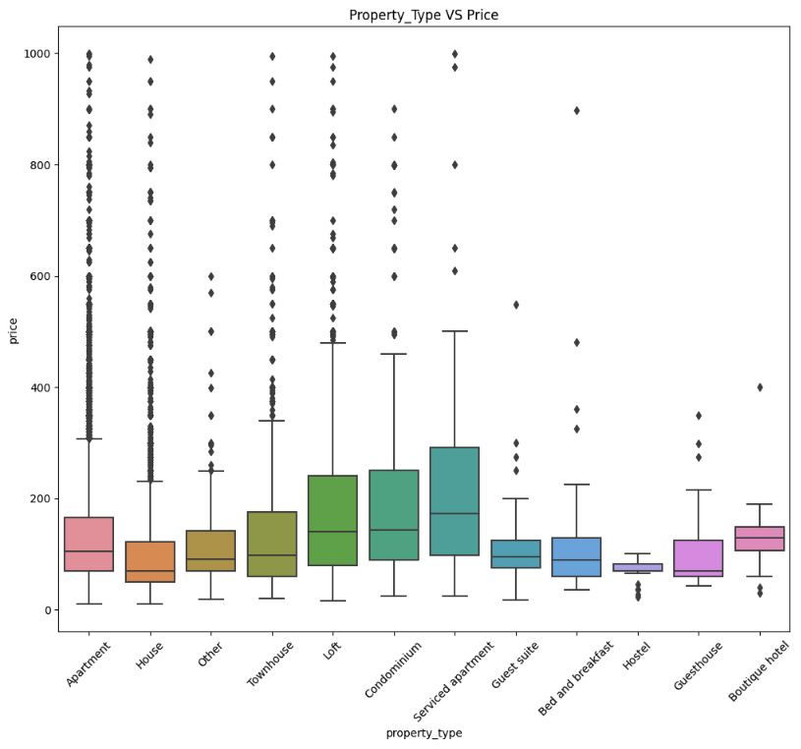
House Type

Slide 15
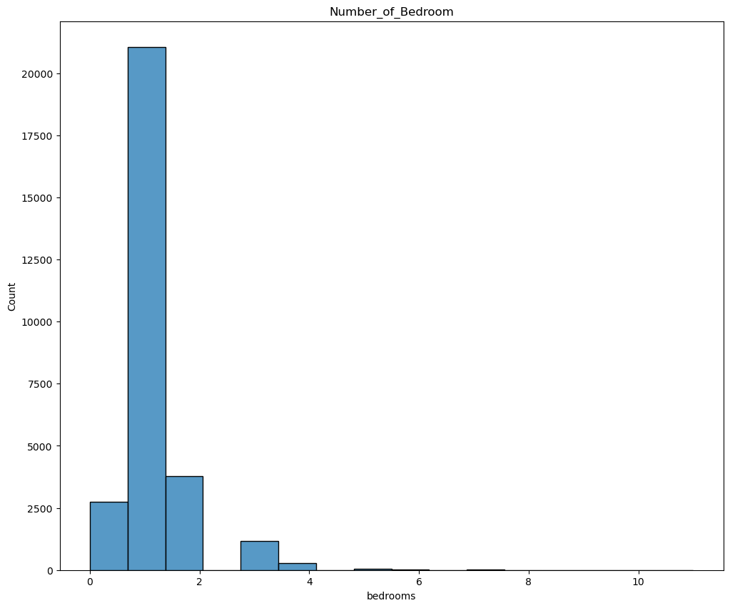
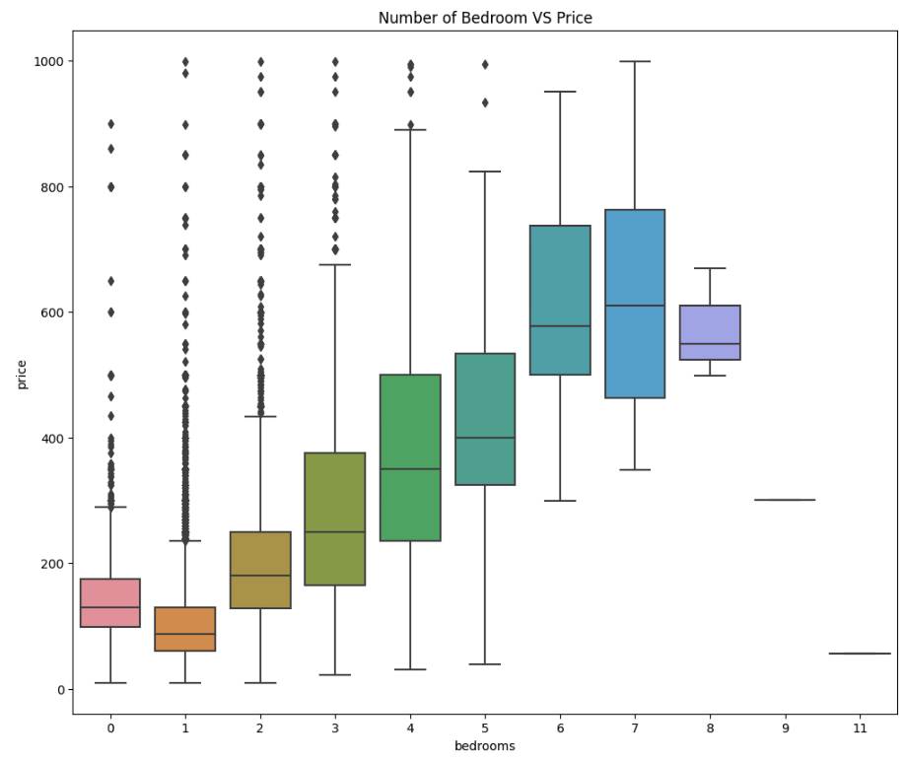
Bedroom Number

Slide 16
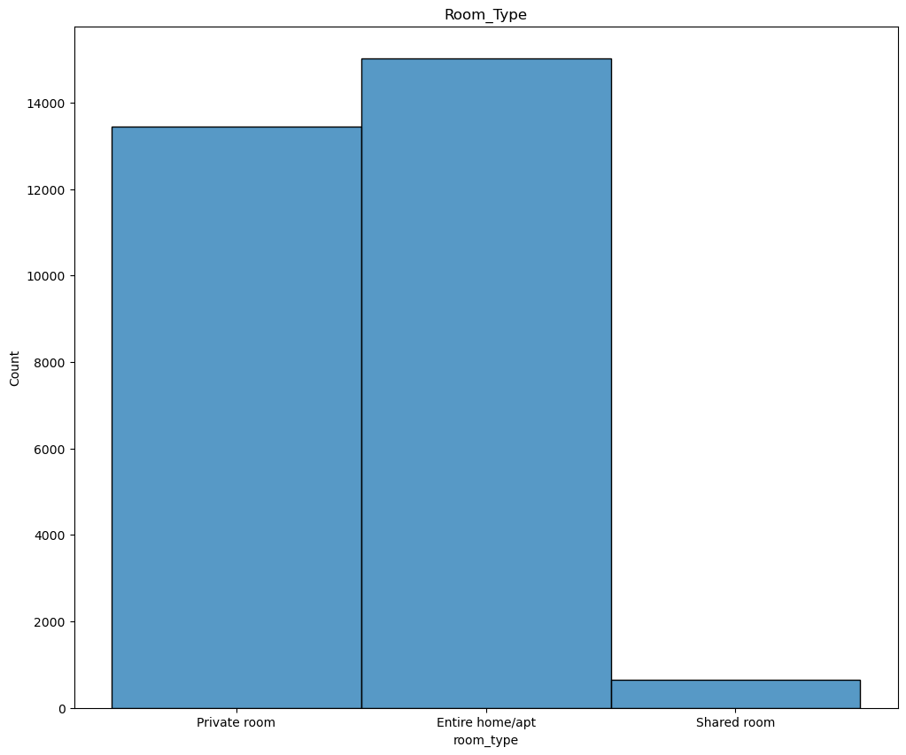
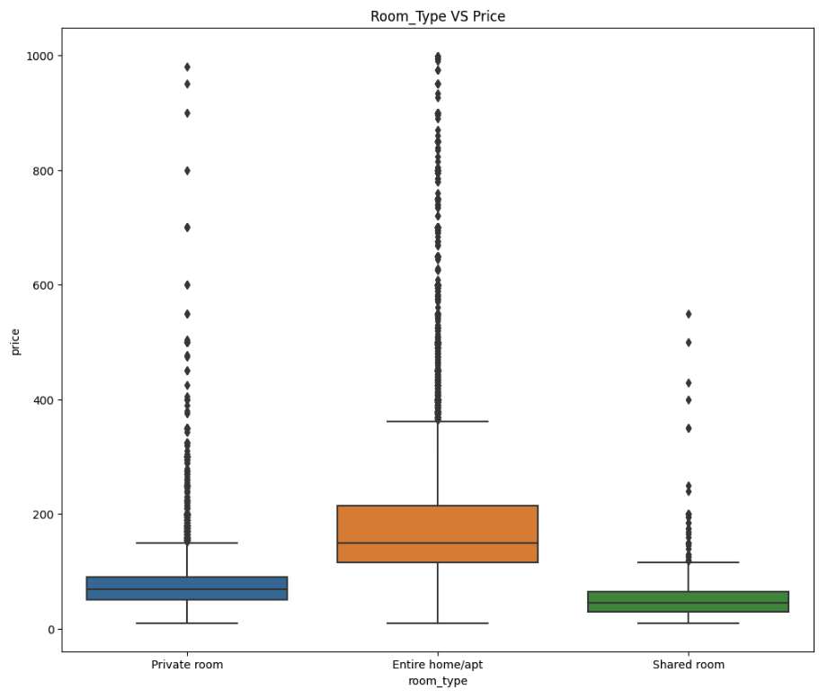
Bedroom Types

Slide 17
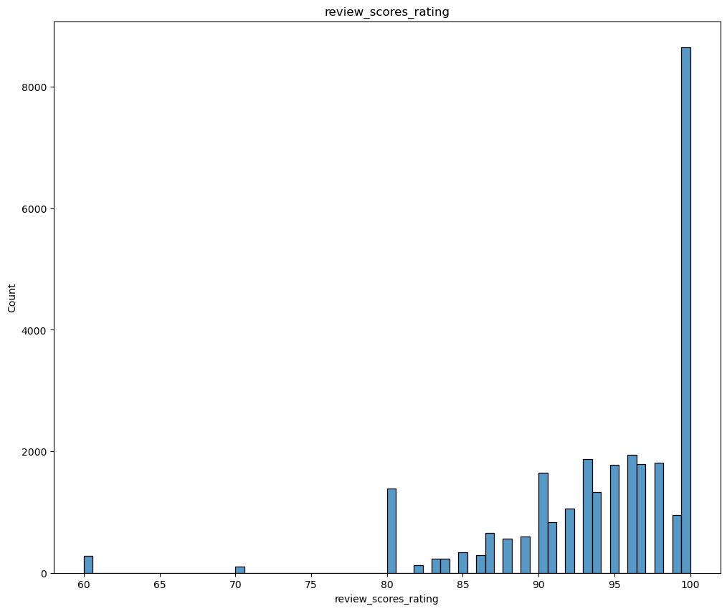
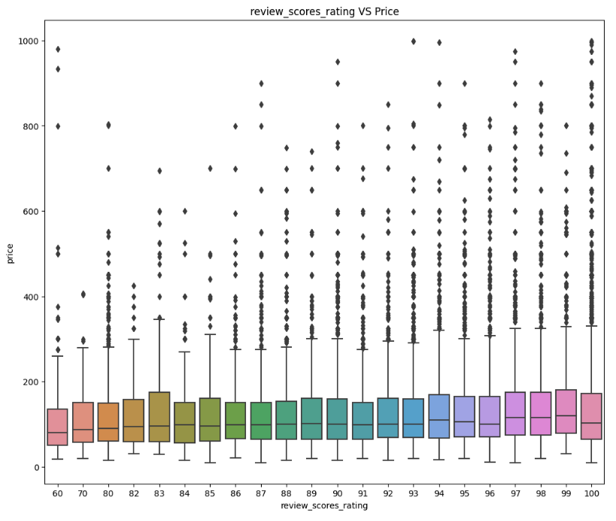
Rating Scores

Slide 18
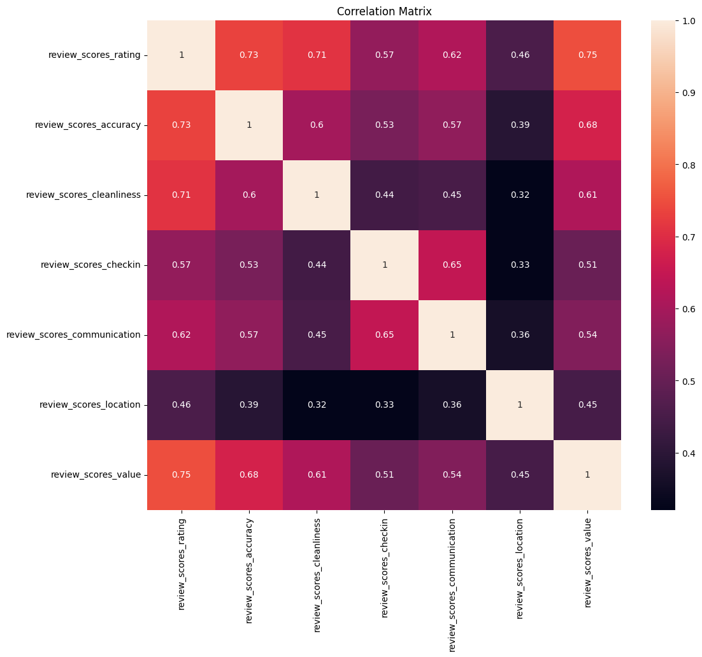
Review Scores Correlation Matrix

Slide 19
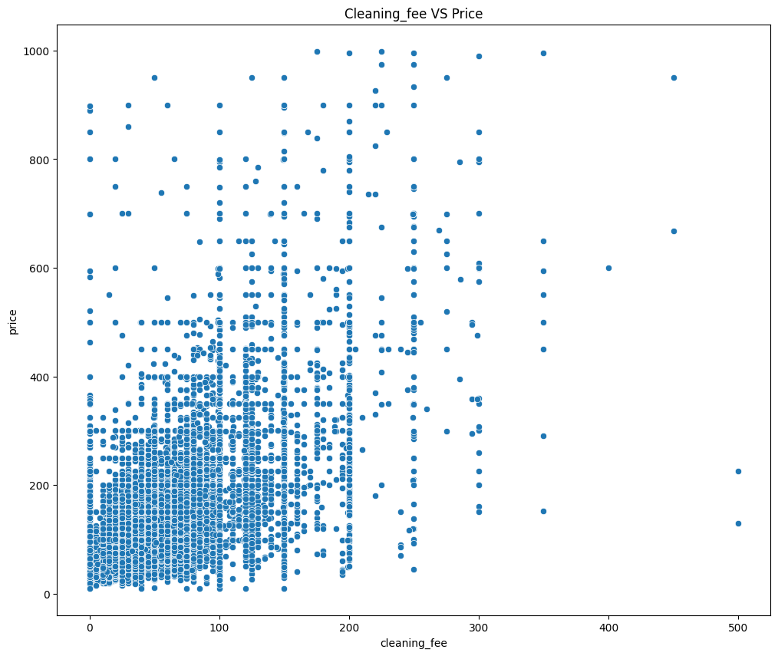
Cleaning Fee V.S. Price

Slide 20
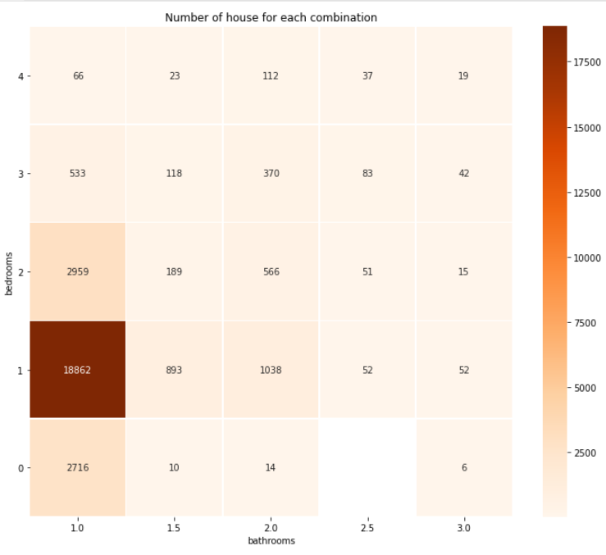
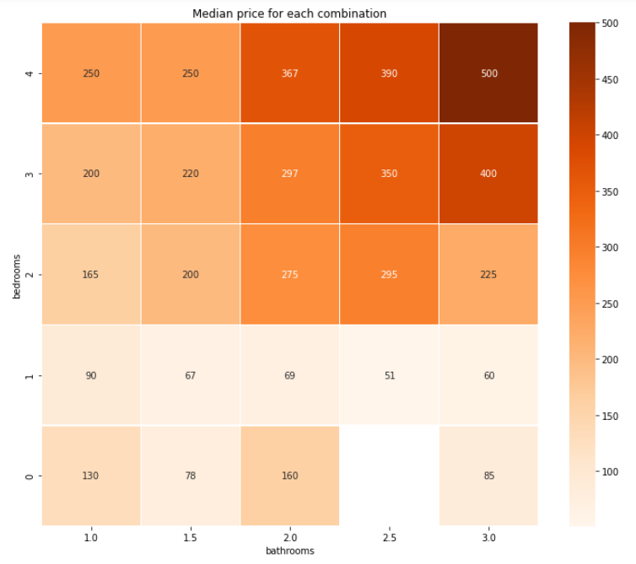
Bathrooms V.S Bedrooms

Slide 21
Machine Learning

Slide 22
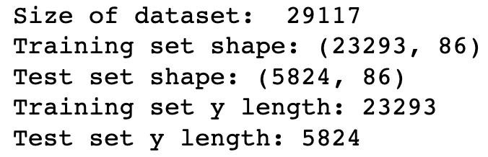
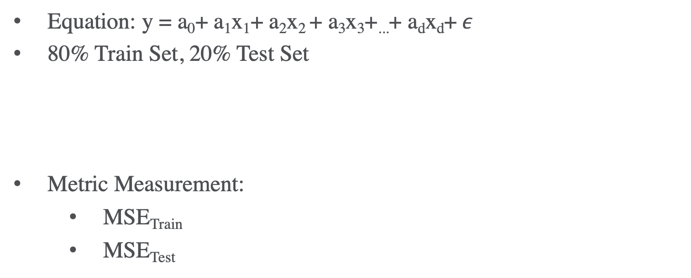
Linear Regression
Equation: y = a₀+ a₁x₁+ a₂x₂ + a₃x₃+...+ a_{d}x_{d}+$ε$
80% Train Set, 20% Test Set
Metric Measurement:
MSE_{Train}
MSE_{Test}

Slide 23
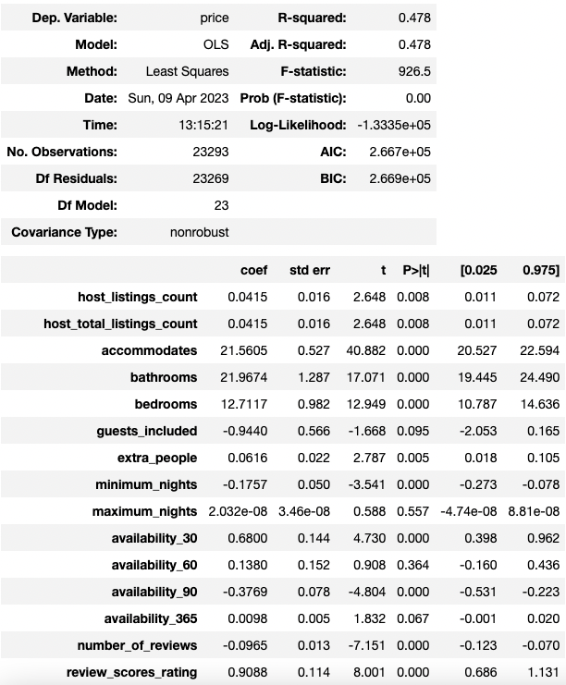
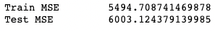
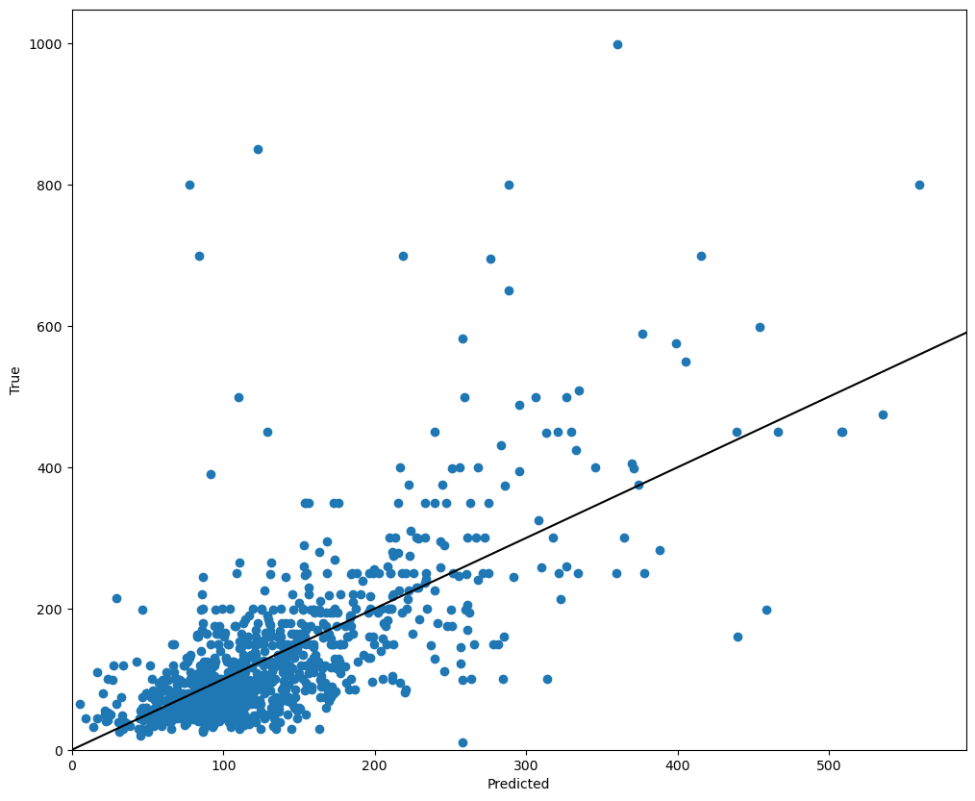
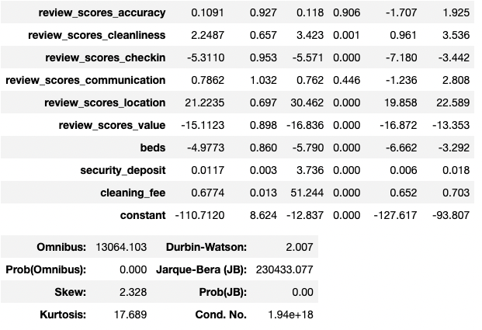
Process
Only includes real-valued data:

Slide 24
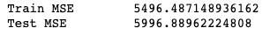

Process
After delete columns with p-value>= 0.05:

Slide 25
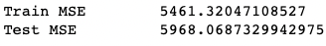
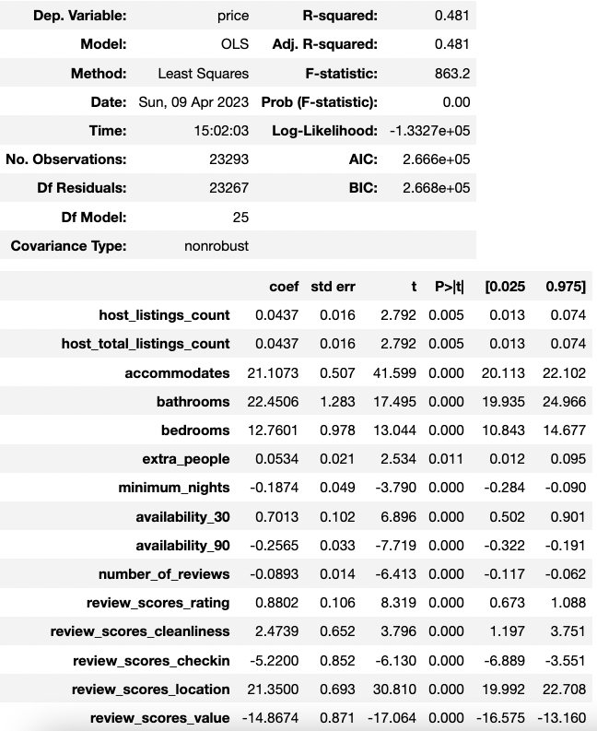
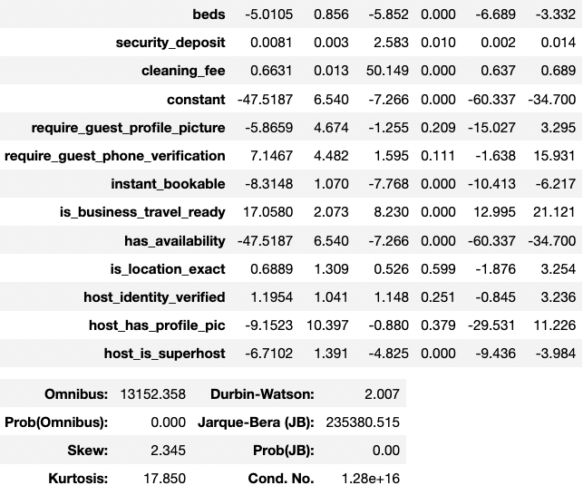

Process
Includes Real-valued data and Boolean data:

Slide 26
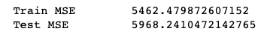

Process
After delete columns with p-value>= 0.05:

Slide 27
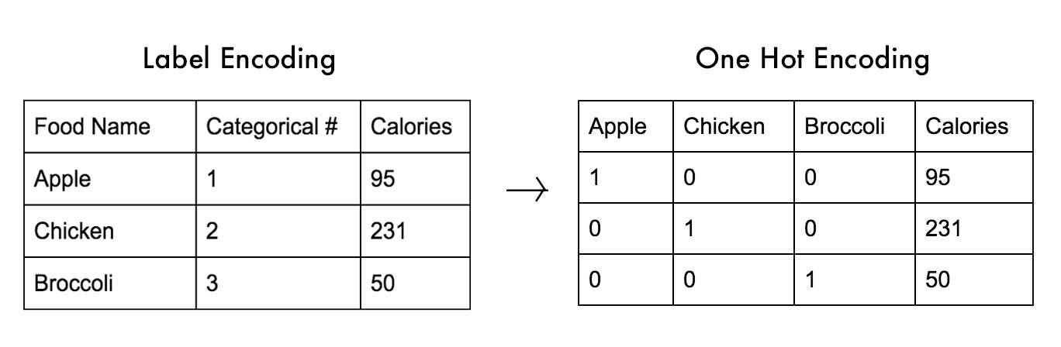
Categorical Data Using One-hot encoding Example
For this data set:
5 Columns → property_type, room_type, bed_type, cancellation_policy, host_response_time

Slide 28
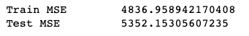
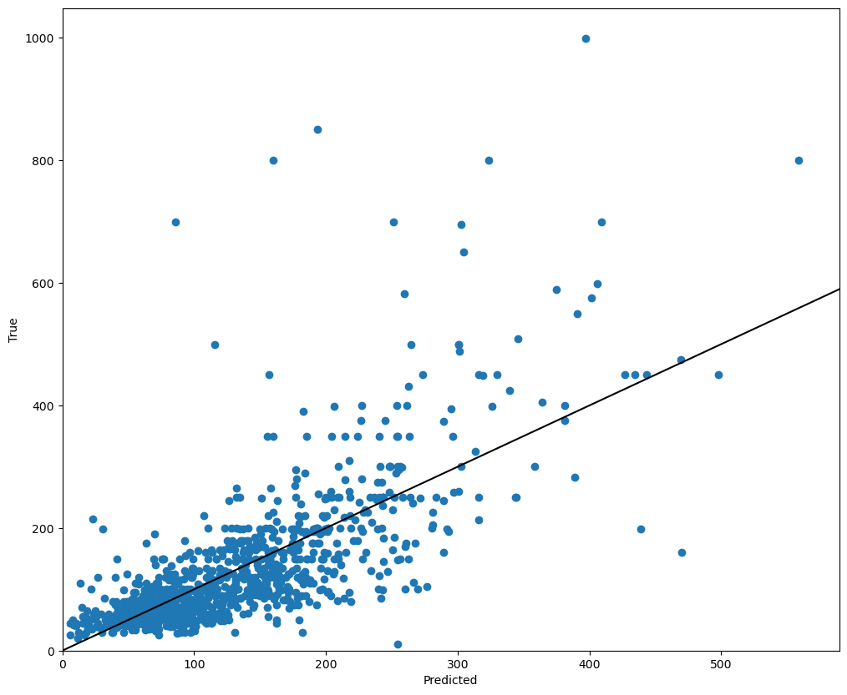
Process
Includes Real-valued data, Boolean data and Categorical data:

Slide 29
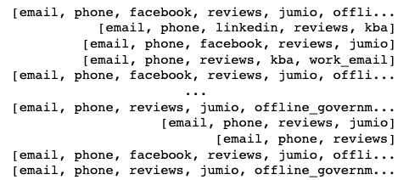
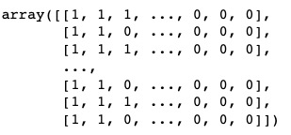
Set Data Using Many-hot encoding Example
For this data set:
1 Column → host_verifications

Slide 30
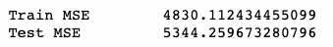

Process
Includes Real-valued data, Boolean data, Categorical data and Set data:

Slide 31
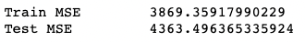
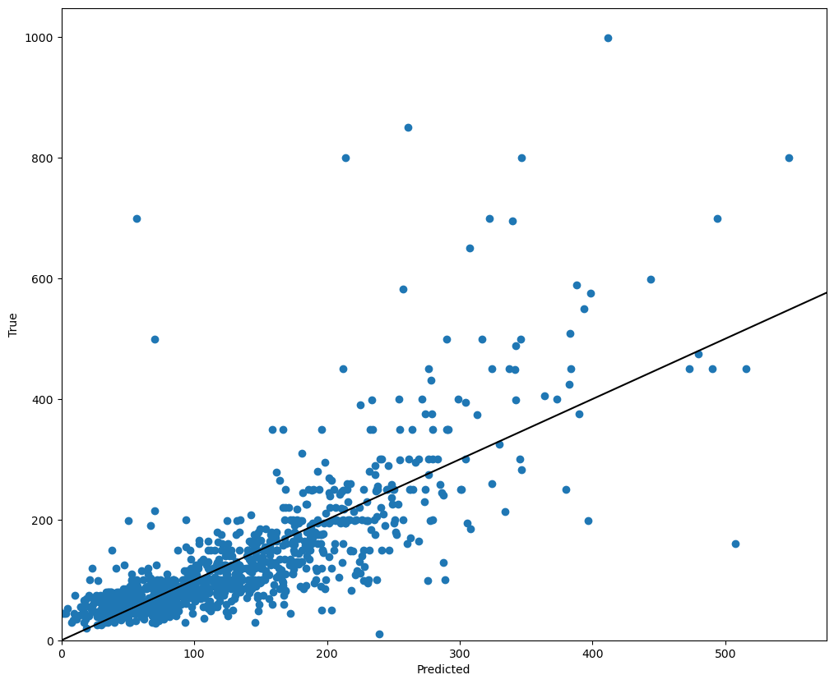
Process
Includes Real-valued data, Boolean data, Categorical data, Set data and Location:

Slide 32
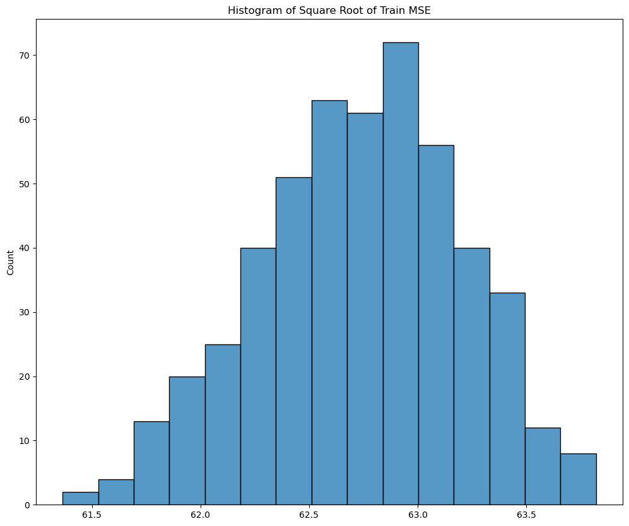
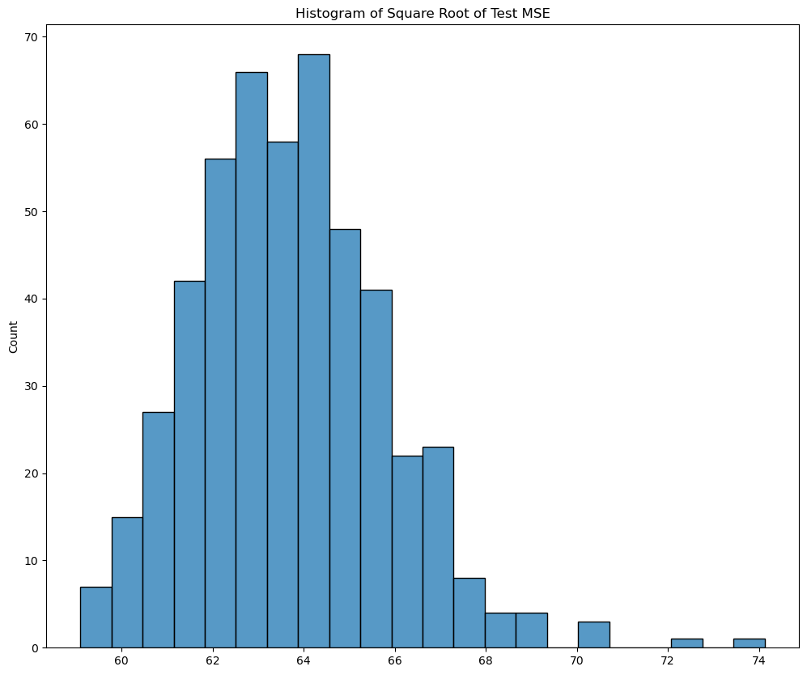
Run Train Test Split For 500 times

Slide 33
Recall the distribution of y variable (price)

Slide 34
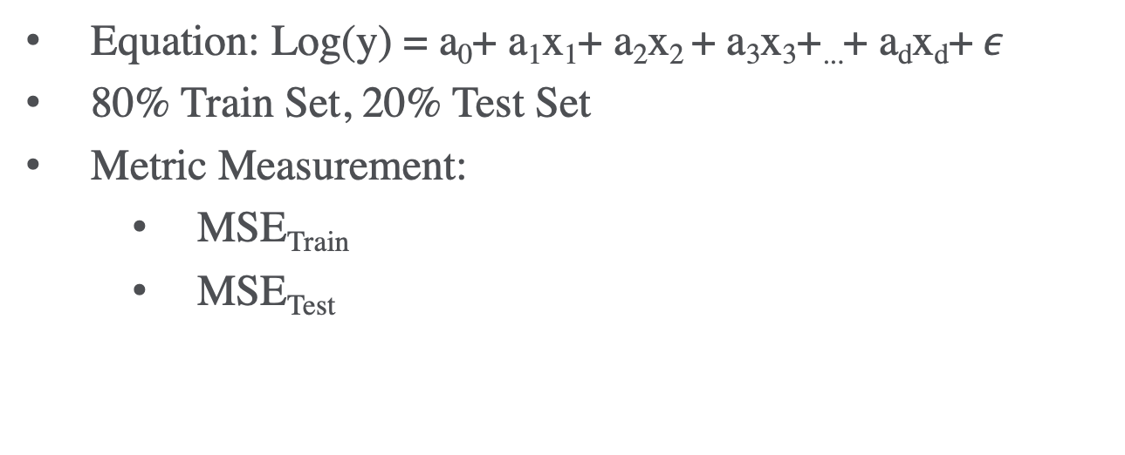
Linear Regression With Log y
Equation: Log(y) = a₀+ a₁x₁+ a₂x₂ + a₃x₃+...+ a_{d}x_{d}+$ε$
80% Train Set, 20% Test Set
Metric Measurement:
MSE_{Train}
MSE_{Test}

Slide 35
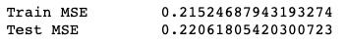
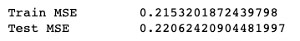
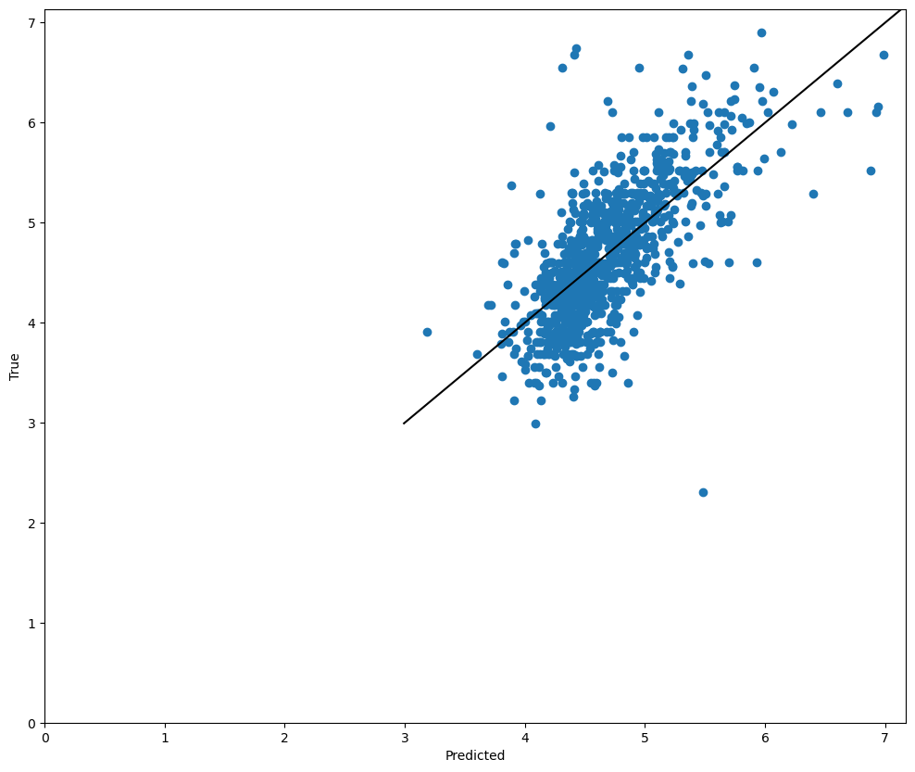

Process
Only includes real-valued data and delete columns with p-value>= 0.05:

Slide 36




Process
Includes Real-valued data and Boolean data and delete columns with p-value>= 0.05:

Slide 37


Process
Includes Real-valued data, Boolean data and Categorical data:

Slide 38


Process
Includes Real-valued data, Boolean data, Categorical data and Set data:

Slide 39


Process
Includes Real-valued data, Boolean data, Categorical data, Set data and Location:

Slide 40
Run Train Test Split For 500 times

Slide 41
Compares Linear Regression for y and log(y)
Linear model for y
Linear model for log(y)

